Slide 1




Bacchus Winery Database Solution
Aysa Jordan and Colton Stone
CSD310: Milestone 5
21 December 2025

Slide 2


Business Background
Bacchus Winery is a family-owned business inherited by Stan and Davis Bacchus three years ago.
The new owners want to modernize operations while keeping existing staff and processes in place.
The winery produces four wines: Merlot, Cabernet, Chablis, and Chardonnay.
Inventory, distribution, and employee information were previously tracked manually or across separate systems.

Slide 3

Case study overview
What Bacchus Winery does:
Problem:
Solution:
Works with multiple suppliers and distributors
Needs better tracking of inventory, sales, and employee workload
Goal is to modernize operations and support business decisions
Supplier delivery performance is difficult to track
Wine sales and distribution data is not centralized
Employee work hours are not easily summarized
Limited visibility into operational performance
Decisions are being made without reliable reporting
Yearly business “snapshot” requires accurate reporting for decision-making
Designed a relational database for core business entities
Centralized data for employees, suppliers, wines, and distributors
Implemented relationships using primary and foreign keys
Enabled reporting to support management decisions
Designed for future expansion

Slide 4





Business Requirements Driving the Database
Track monthly supplier deliveries and identify delays
Monitor wine sales by brand and distributor
Summarize employee work hours by quarter and year
Support management reporting for inventory, sales, and staffing decisions

Slide 5
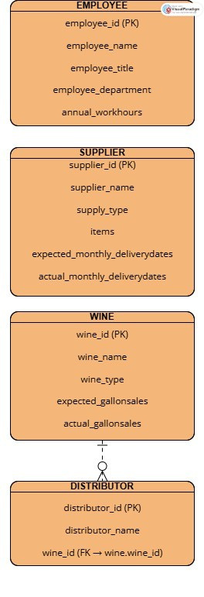
Finalized ERD
+ DATABASE DESIGN
Visual representation of all database entities
Shows relationships between tables using primary and foreign keys
Ensures data consistency and integrity
Tables designed using Third Normal Form (3NF)
Each table represents a single business entity
No repeating groups or partial dependencies
Reduced data redundancy
Supports efficient querying and reporting

Slide 6

REPORTS OVERVIEW
The following reports were generated from the database to support management decision-making at Bacchus Winery. Each report directly addresses a business concern identified in the case study, including supplier reliability, wine sales performance, and employee workload.

Slide 7


SUPPLIER DELIVERY REPORT
This report evaluates supplier delivery performance across all twelve months of the year.
Green Glass & Packaging demonstrated the strongest performance, meeting delivery schedules 12 out of 12 months.
Daily Express met delivery expectations for 10 out of 12 months, with delays occurring in January and December.
G3 Industries met delivery schedules 9 out of 12 months, with missed deliveries in February, April, and September.
Overall, Green Glass & Packaging proved to be the most reliable supplier, while Daily Express and G3 Industries showed occasional consistency issues.
These results help identify which suppliers may require closer monitoring or potential process improvements.

Slide 8

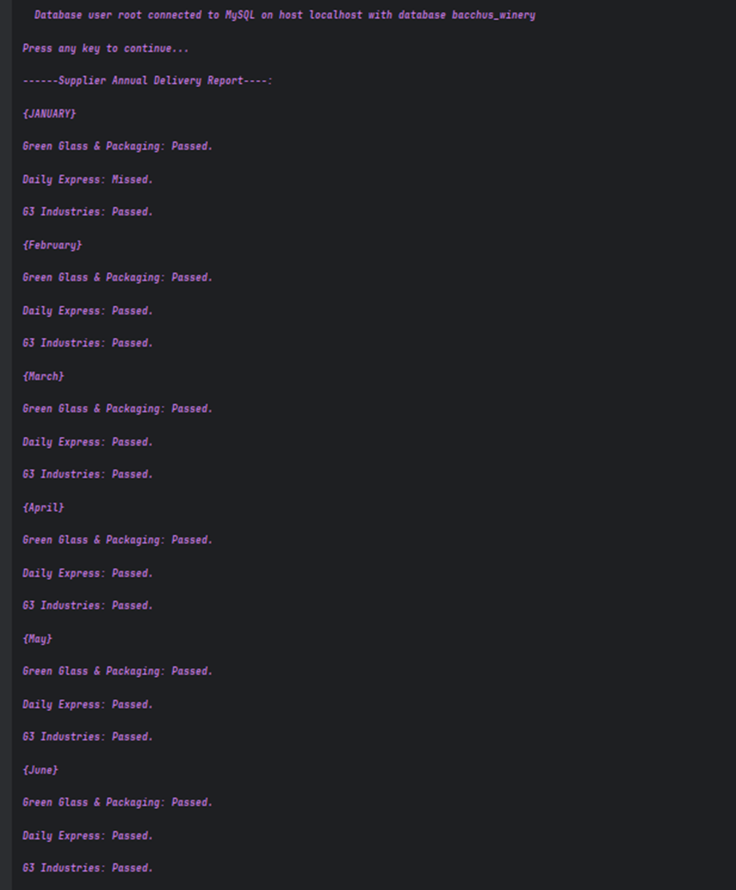
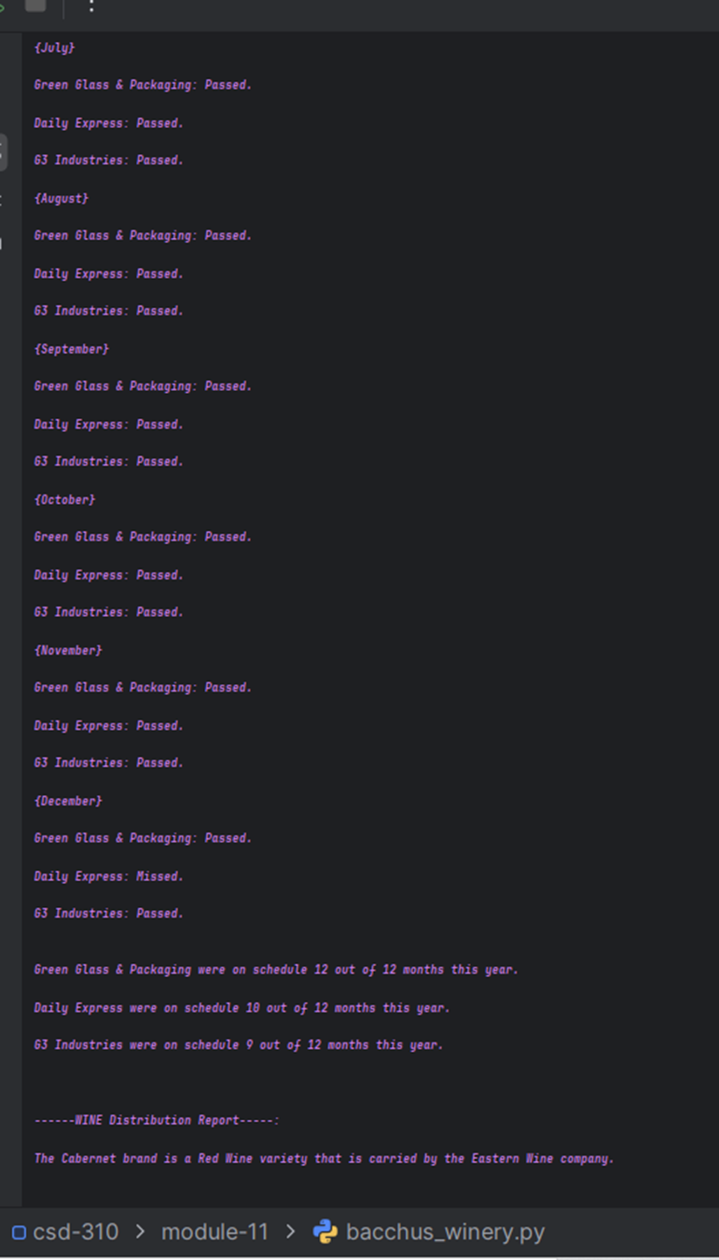

Supplier Delivery Report - Output
Percentage of Alcohol
This report highlights delivery delays over time, allowing management to identify unreliable suppliers.
13.0 %

Slide 9



Distributor & Sales Report
This report analyzes wine distribution partnerships and annual sales performance by brand.
Cabernet (Red Wine) is distributed by Eastern Wine Company and met expected sales targets.
Chablis (White Wine) is distributed by Pacific Exports and also met expected sales targets.
Chardonnay (White Wine) is distributed by Liquor Warehouse and underperformed, selling approximately 3,000 gallons below expectations.
Merlot (Red Wine) is distributed by Georgia Vinery Company and underperformed, selling approximately 4,000 gallons below expectations.
Cabernet recorded the highest total sales, while Chardonnay recorded the lowest.
These results indicate that Chardonnay and Merlot may require pricing, marketing, or distribution strategy adjustments.

Slide 10

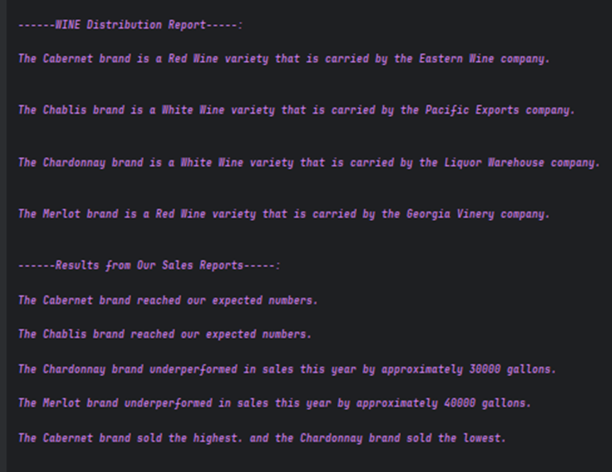
Distributor and Sales Report - Output
This report allows management to identify underperforming wines and evaluate distribution strategies.

Slide 11

Employee Hours
Report:
This report summarizes total annual work hours for each employee at Bacchus Winery.
Davis Bacchus and Stan Bacchus, serving as Inventory Co-Managers, each worked approximately 3,000 hours, representing the highest workload.
Janet Collins (Payroll Manager), Roz Murphy (Marketing Manager), Henry Doyle (Production Manager), and Maria Costanza (Distribution Manager) each worked approximately 2,500 hours.
Bob Ulrich, Marketing Assistant, worked approximately 2,000 hours, the lowest total among employees.
Overall, all employees worked within expected and reasonable annual hour ranges based on their roles.
The report helps management evaluate workload distribution and staffing balance across departments.

Slide 12
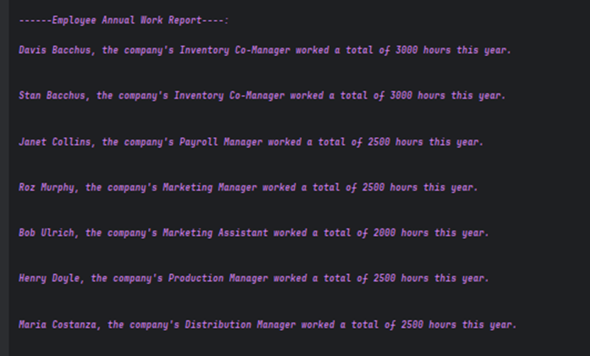

Employee Hours Report - Output
This report helps assess workload balance and staffing efficiency across departments.

Slide 13
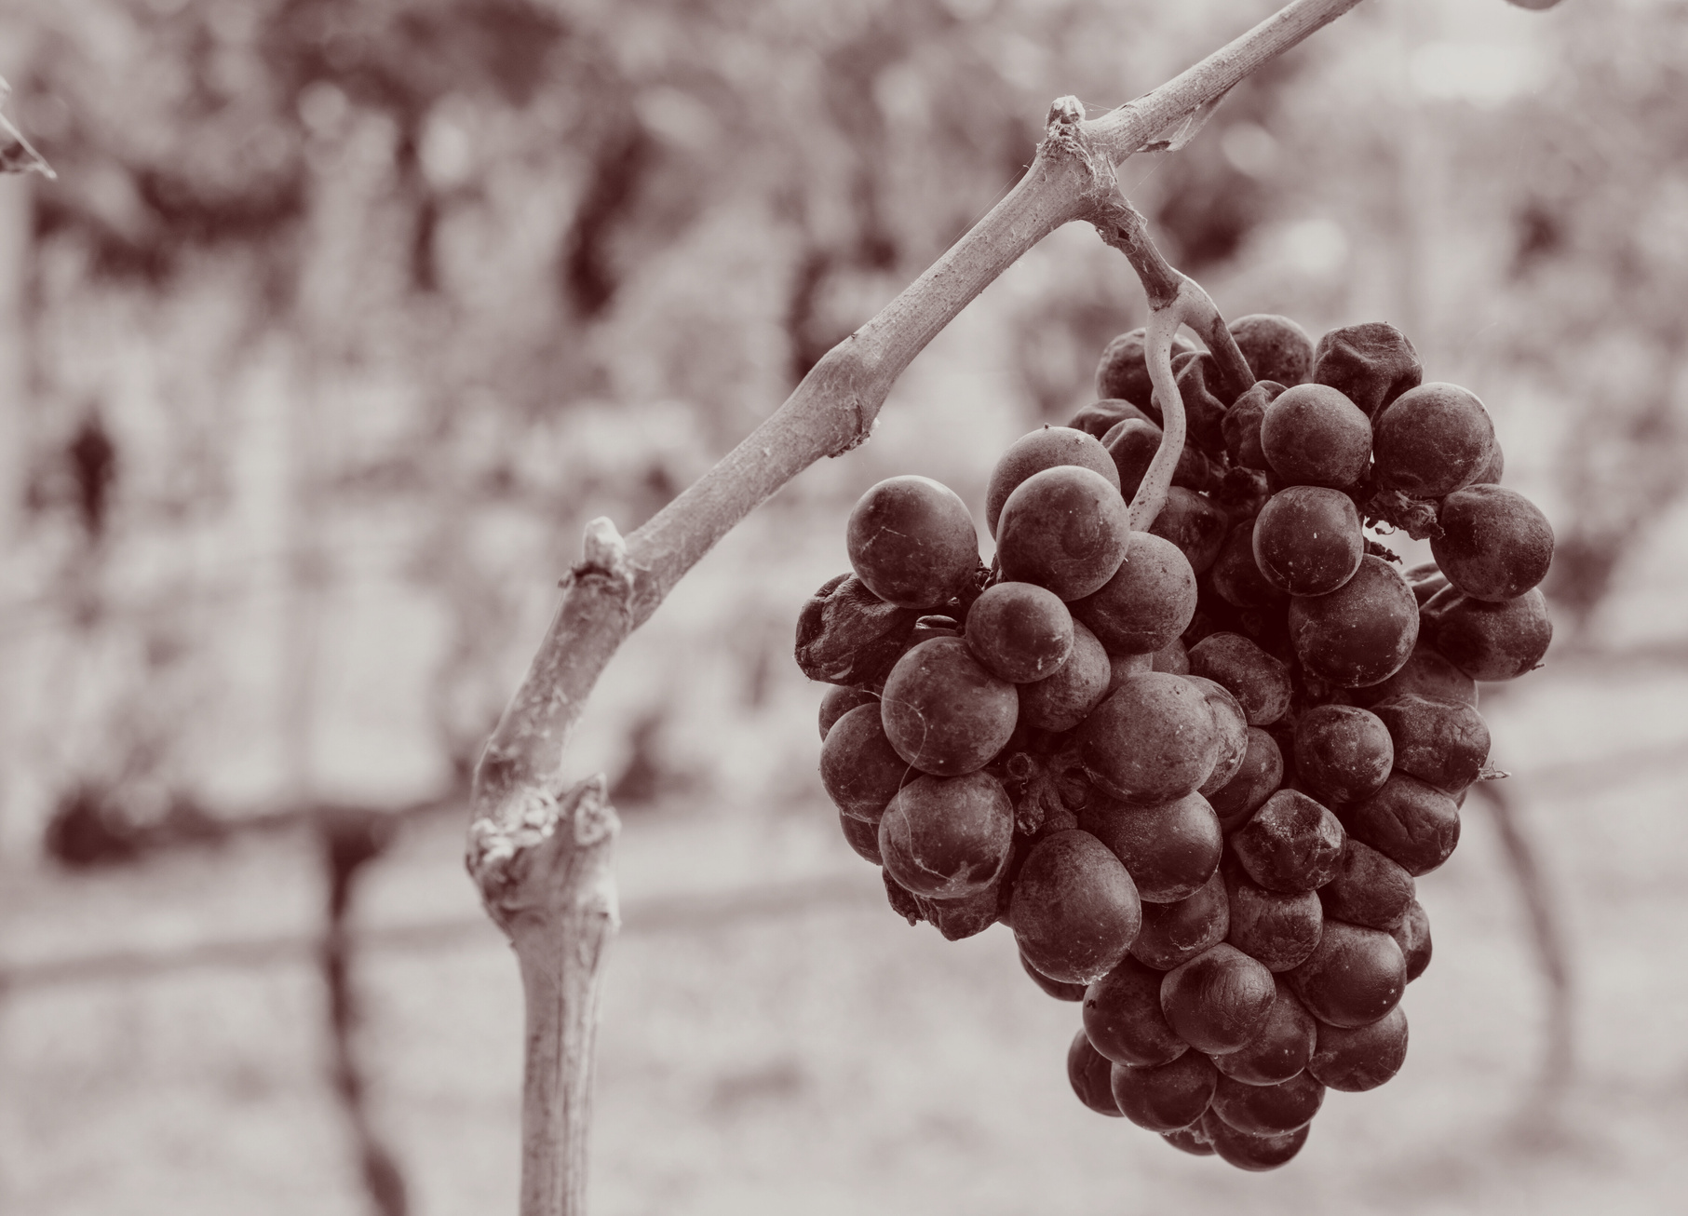
ASSUMPTIONS
Employee work hours are summarized by period (monthly or quarterly)
Supplier deliveries occur on a recurring, roughly monthly basis
Distributor orders represent wine sales and shipments
Inventory tracks supply items only, not bottled wine
Wine production quantities are outside the scope of this project

Slide 14





Conclusion
Database centralizes winery operations data
Reporting improves visibility and decision-making
Design meets case study requirements
System is scalable for future enhancements

Slide 15


Thank you for your attention!
— Aysa Jordan and Colton Stone

